Slide 1
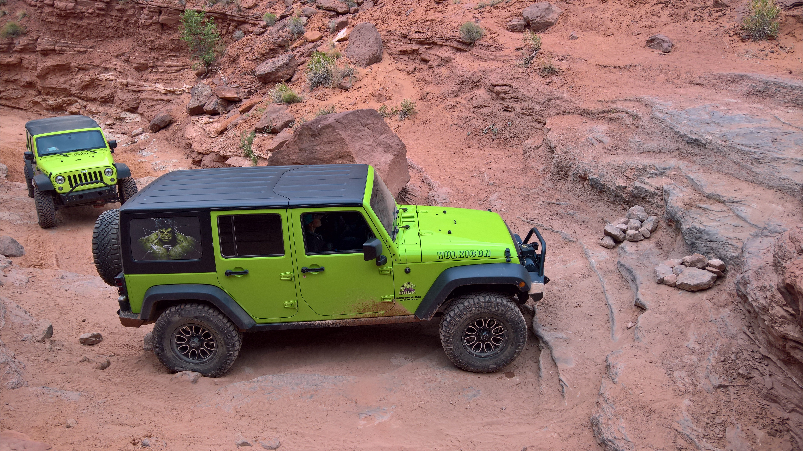
Rock Crawling
Moab, Utah

Slide 2
Why Rock Crawl in Moab, Utah?
Adventurous
Nearby Lodging and Restaurants
Affordable ($250-400/day vehicle rentals)
Family Friendly
Incredible fun!

Slide 3
Most Popular
Trail Name | Round Trip from Moab | 4WD Road | Minimum Time | Difficulty
1. Chicken Corners | 54 miles | 43 miles | 3-1/2 hours | Hard
2. Gemini Bridges | 48 Miles | 14 miles | 2-1/2 hours | Easy
3. Poison Spider | 36 miles | 16 miles | 4 hours | Difficult
4. Moab Rim | 15 miles | 7 miles | 1-1/2 hours | Very Difficult

Slide 4
Other Activities
Rafting
Mountain Biking
Hiking
Canyoneering
Photography

Slide 5
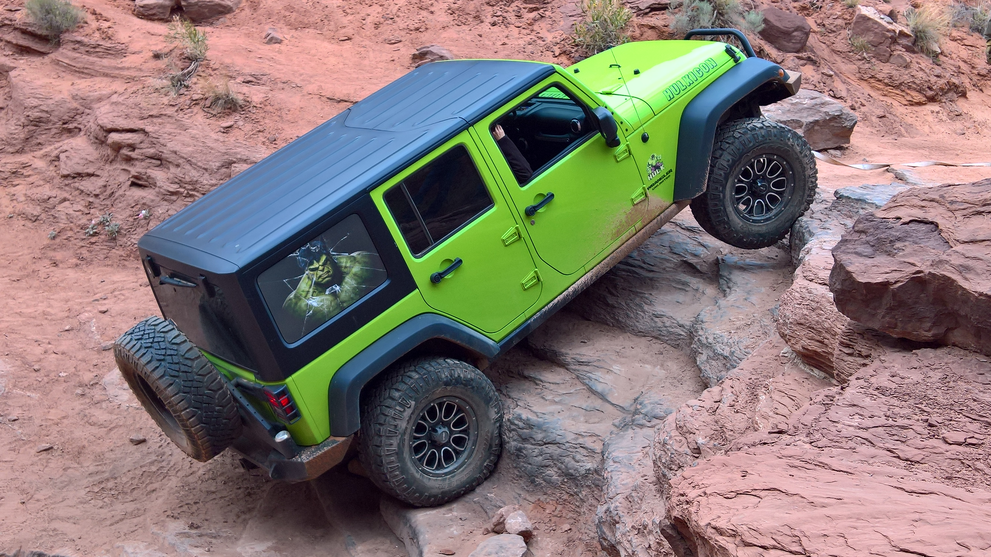
Adventurous Trails!
Trails range from easy 2-wheel scenic drives to the ultimate in challenging 4-wheel drive trails, providing opportunities for all to experience the beauty and solitude of an off-road adventure.

